Slide 1


Lecture 6
DLI
Jointly Distributed Random Variables
联合分布随机变量

Slide 2
DLI
Outline
Joint Distribution Functions 联合分布函数
Independent Random Variables 独立随机变量
Conditional Distributions 条件分布
Joint Probability Distribution of Functions of Random Variables 随机变量函数的联合分布

Slide 3
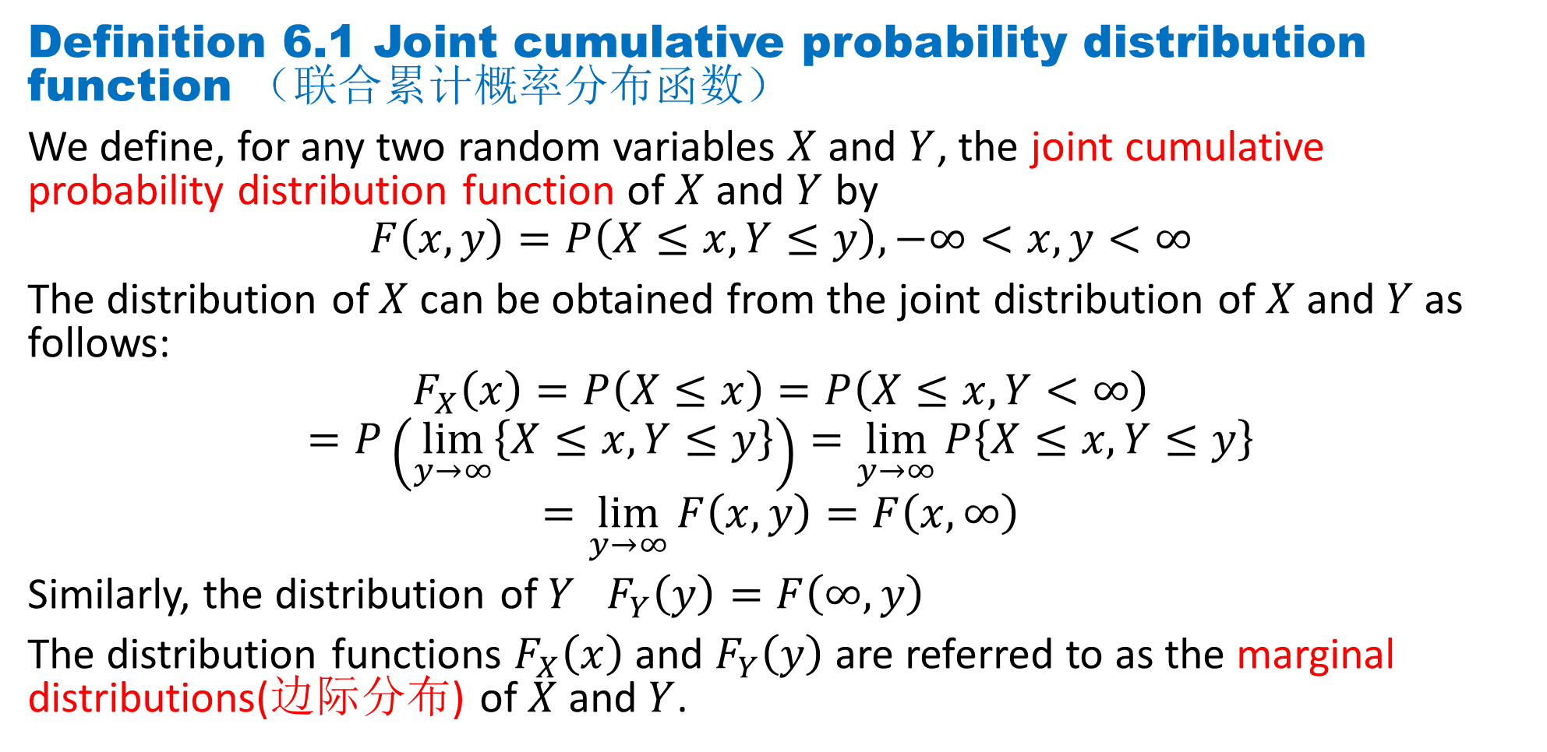
DLI
Definition 6.1 Joint cumulative probability distribution function （联合累计概率分布函数）
We define, for any two random variables $X$and $Y$, the joint cumulative probability distribution function of $X$and $Y$ by
$$F\left(x, y\right)=P\left(X≤x, Y≤y\right),−∞<x,y<∞$$
The distribution of $X$can be obtained from the joint distribution of $X$and $Y$as follows:
$$F_{X}\left(x\right)=P\left(X≤x\right)=P\left(X≤x, Y<∞\right)$$
$$=P\left(\lim_{y→∞}\left\{X≤x, Y≤y\right\}\right)=\lim_{y→∞}{P\left\{X≤x, Y≤y\right\}}$$
$$=\lim_{y→∞}{F\left(x, y\right)}=F\left(x, ∞\right)$$
Similarly, the distribution of $Y$ $F_{Y}\left(y\right)=F\left(∞,y\right)$
The distribution functions $F_{X}\left(x\right)$ and $F_{Y}\left(y\right)$ are referred to as the marginal distributions(边际分布) of $X$and $Y$.

Slide 4
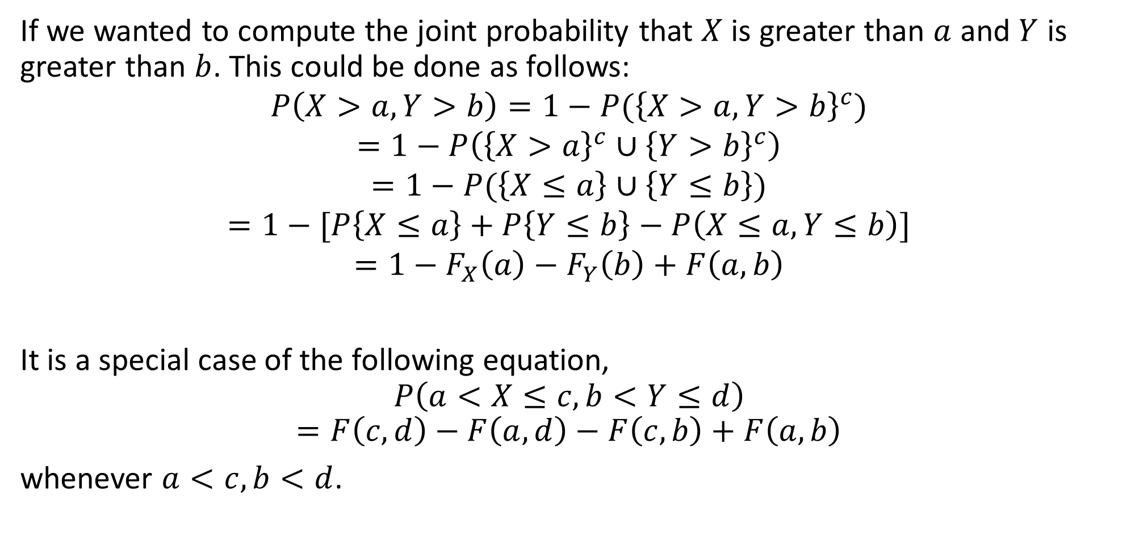
DLI
If we wanted to compute the joint probability that $X$ is greater than $a$ and $Y$ is greater than $b$. This could be done as follows:
$$P\left(X>a,Y>b\right)=1−P({\left\{X>a,Y>b\right\}}^{c})$$
$$=1−P\left({\left\{X>a\right\}}^{c}∪{\left\{Y>b\right\}}^{c}\right)$$
$$=1−P(\left\{X≤a\right\}∪\left\{Y≤b\right\})$$
$$=1−[P\left\{X≤a\right\}+P\left\{Y≤b\right\}−P\left(X≤a, Y≤b\right)]$$
$$=1−F_{X}\left(a\right)−F_{Y}\left(b\right)+F\left(a, b\right)$$
It is a special case of the following equation,
$$P\left(a<X≤c,b<Y≤d\right)$$
$$=F\left(c, d\right)−F\left(a, d\right)−F\left(c, b\right)+F\left(a, b\right)$$
whenever $a<c,b<d$.

Slide 5
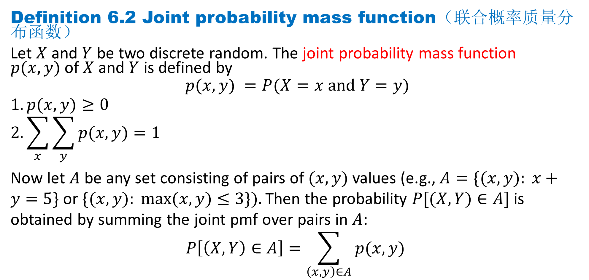
DLI
Definition 6.2 Joint probability mass function（联合概率质量分布函数）
Let $X$and $Y$ be two discrete random. The joint probability mass function $p(x, y)$of $X$and $Y$ is defined by
$$p(x, y) =P(X=x and Y=y)$$
$$1.p(x, y)≥0$$
$$2.\sum_{x}{\sum_{y}{p(x, y)}}=1$$
Now let $A$ be any set consisting of pairs of $(x, y)$values (e.g., $A=\{(x, y): x+y=5\}$or $\{(x, y): max⁡(x, y)≤3\}).$Then the probability $P[(X, Y)∈A]$is obtained by summing the joint pmf over pairs in $A$:
$$P\left[\left(X, Y\right)∈A\right]=\sum_{\left(x, y\right)∈A}{p(x, y) }$$

Slide 6
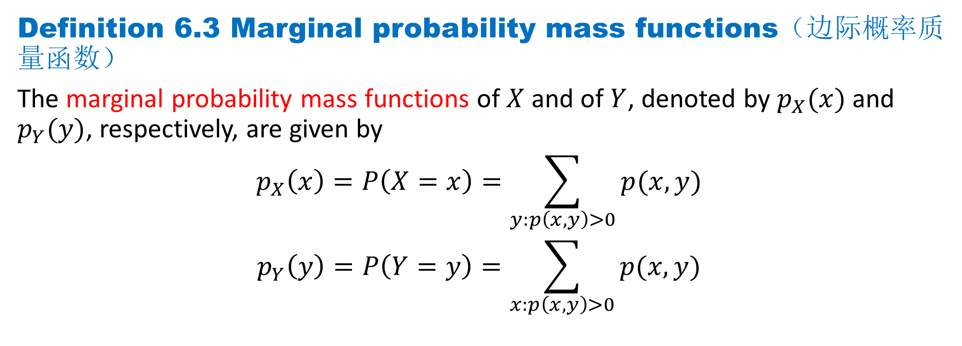
DLI
Definition 6.3 Marginal probability mass functions（边际概率质量函数）
The marginal probability mass functions of $X$and of $Y$, denoted by $p_{X}(x)$ and $p_{Y}(y)$, respectively, are given by
$$p_{X}\left(x\right)=P\left(X=x\right)=\sum_{y:p\left(x, y\right)>0}{p(x, y) }$$
$$p_{Y}\left(y\right)=P\left(Y=y\right)=\sum_{x:p\left(x, y\right)>0}{p(x, y) }$$

Slide 7
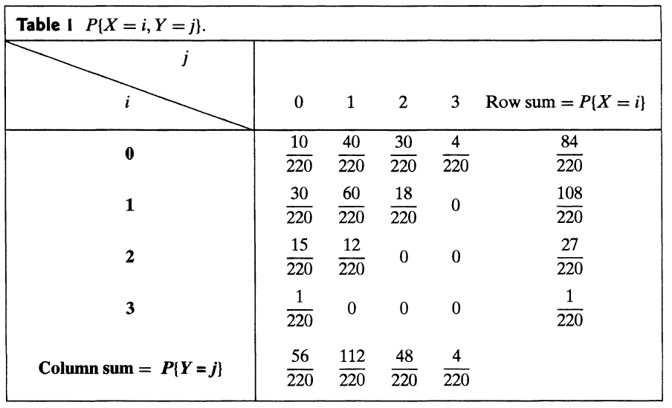

DLI
Example 6.1
Suppose that 3 balls are randomly selected from an urn containing 3 red, 4 white, and 5 blue balls. If we let $X$ and $Y$ denote, respectively, the number of red and white balls chosen, then the joint probability mass function of $X$ and $Y$,$p(i,j)= P\{X=i, Y=j\}$, is given by
For example，
$$P\{X=1, Y=1\}$$
$$=\frac{\left(\begin{matrix}3 \\ 1\end{matrix}\right)\left(\begin{matrix}4 \\ 1\end{matrix}\right)\left(\begin{matrix}5 \\ 1\end{matrix}\right)}{\left(\begin{matrix}12 \\ 3\end{matrix}\right)}$$
$$=\frac{60}{220}$$

Slide 8
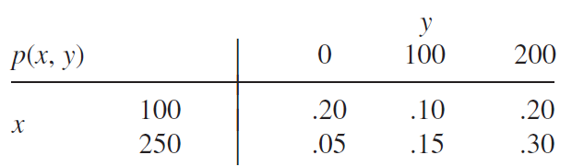
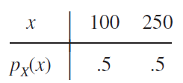
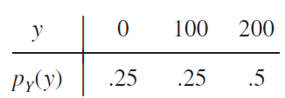

DLI
Example 6.2
joint probability table
The marginal pmf of $X$ is
$$p_{X}(100)=0.50$$
$$p_{X}(250)=0.50$$
The marginal pmf of $Y$ is
$$p_{Y}(0)=0.25$$
$$p_{Y}(100)=0.25$$
$$p_{Y}(200)=0.50$$

Slide 9
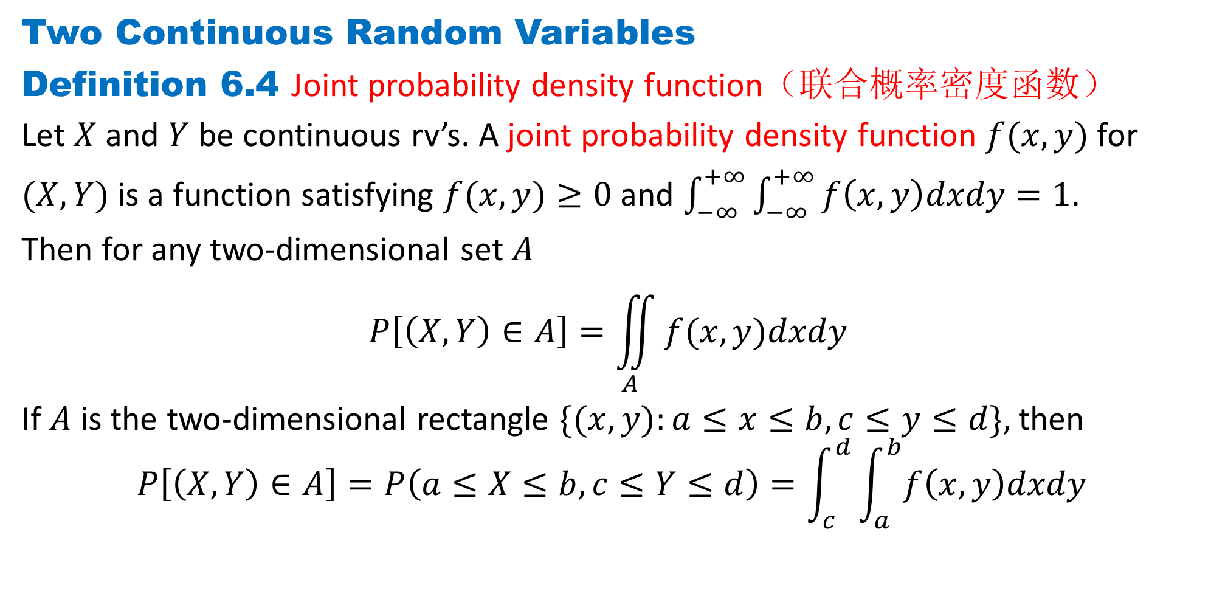
DLI
Two Continuous Random Variables
Definition 6.4 Joint probability density function（联合概率密度函数）
Let $X$ and $Y$ be continuous rv’s. A joint probability density function $f(x, y)$for
$(X,Y)$is a function satisfying $f(x, y)≥0$and $\int_{−∞}^{+∞}{\int_{−∞}^{+∞}{f\left(x, y\right)dxdy}}=1$.
Then for any two-dimensional set $A$
$$P\left[\left(X, Y\right)∈A\right]=\iint_{A}{f(x, y)dxdy }$$
If $A$ is the two-dimensional rectangle $\{(x, y):a≤x≤b, c≤y≤d\},$ then
$$P\left[\left(X, Y\right)∈A\right]=P\left(a≤X≤b, c≤Y≤d\right)=\int_{c}^{d}{\int_{a}^{b}{f\left(x, y\right)dxdy}}$$

Slide 10
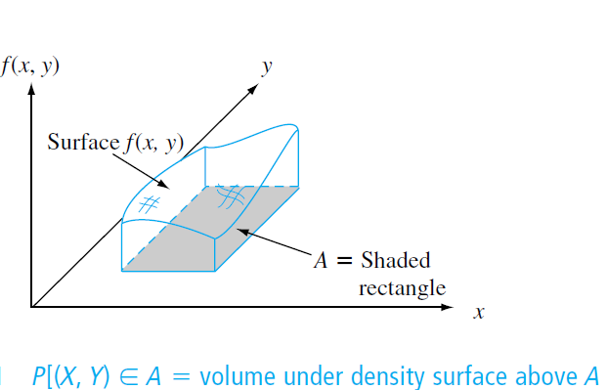

DLI
$P[(X, Y)∈A]$ is the volume underneath this surface and above the region $A.$

Slide 11
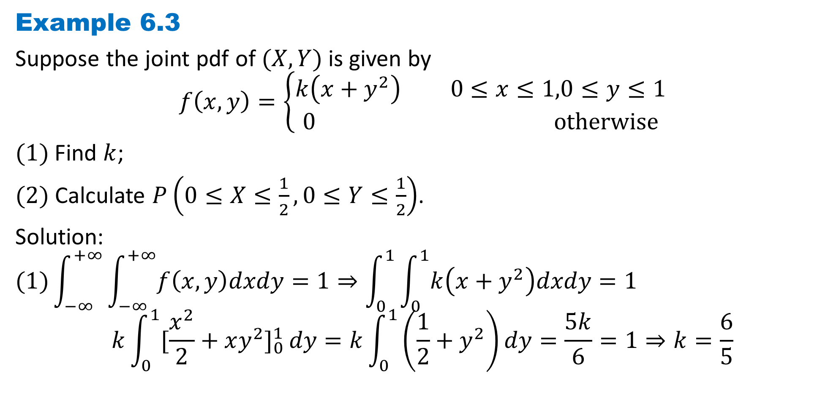
DLI
Example 6.3
Suppose the joint pdf of $(X, Y)$is given by
$$f\left(x,y\right)=\left\{\begin{aligned}k\left(x+y^{2}\right) 0≤x≤1,0≤y≤1 \\ 0 otherwise\end{aligned}\right.$$
$(1)$Find $k$;
$(2)$ Calculate $P\left(0≤X≤\frac{1}{2}, 0≤Y≤\frac{1}{2}\right)$.
Solution:
$$(1)\int_{−∞}^{+∞}{\int_{−∞}^{+∞}{f\left(x, y\right)dxdy}}=1⇒\int_{0}^{1}{\int_{0}^{1}{k\left(x+y^{2}\right)dxdy}}=1$$
$$k\int_{0}^{1}{[\frac{x^{2}}{2}+xy^{2}]_{0}^{1}}dy=k\int_{0}^{1}{\left(\frac{1}{2}+y^{2}\right)}dy=\frac{5k}{6}=1⇒k=\frac{6}{5}$$

Slide 12

DLI
$$f\left(x,y\right)=\left\{\begin{aligned}\frac{6}{5}\left(x+y^{2}\right) 0≤x≤1,0≤y≤1 \\ 0 otherwise\end{aligned}\right.$$
$(2)$
$$P\left(0≤X≤\frac{1}{2}, 0≤Y≤\frac{1}{2}\right)=\int_{0}^{\frac{1}{2}}{\int_{0}^{\frac{1}{2}}{\frac{6}{5}\left(x+y^{2}\right)dx}dy}$$
$$=\frac{6}{5}\int_{0}^{\frac{1}{2}}{[\frac{x^{2}}{2}+xy^{2}]_{0}^{\frac{1}{2}}}dy=\frac{6}{5}\int_{0}^{\frac{1}{2}}{\left(\frac{1}{8}+{\frac{1}{2}y}^{2}\right)}dy=\frac{1}{10}$$

Slide 13
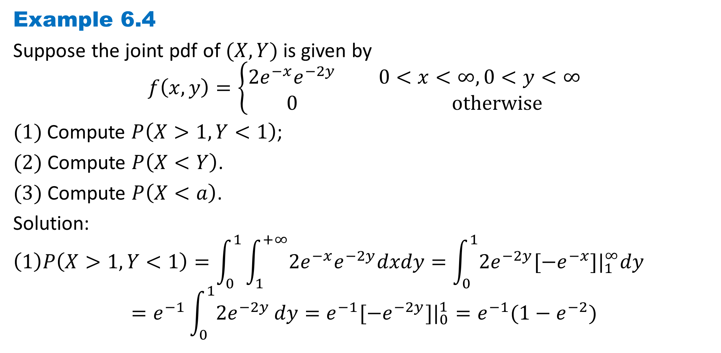
DLI
Example 6.4
Suppose the joint pdf of $(X, Y)$is given by
$$f\left(x,y\right)=\left\{\begin{aligned}2e^{−x}e^{−2y} 0<x<∞,0<y<∞ \\ 0 otherwise\end{aligned}\right.$$
$(1)$Compute $P\left(X>1, Y<1\right)$;
$(2)$ Compute $P\left(X<Y\right)$.
$(3)$ Compute $P\left(X<a\right)$.
Solution:
$$\left(1\right)P\left(X>1, Y<1\right)=\int_{0}^{1}{\int_{1}^{+∞}{2e^{−x}e^{−2y}dxdy}}=\int_{0}^{1}{2e^{−2y}[−e^{−x}]|_{1}^{∞}dy}$$
$$=e^{−1}\int_{0}^{1}{2e^{−2y}}dy=e^{−1}[−e^{−2y}]|_{0}^{1}=e^{−1}(1−e^{−2})$$

Slide 14

DLI
$(2)$ $P\left(X<Y\right)=\int_{0}^{∞}{\int_{0}^{y}{2e^{−x}e^{−2y}dx}dy}$
$$=\int_{0}^{∞}{2e^{−2y}[−e^{−x}]_{0}^{y}}dy=\int_{0}^{∞}{2e^{−2y}\left(1−e^{−y}\right)}dy$$
$$=\int_{0}^{∞}{2e^{−2y}}dy−\int_{0}^{∞}{2e^{−3y}}dy=1−\frac{2}{3}=\frac{1}{3}$$
$(3)$ $P\left(X<a\right)=\int_{0}^{a}{\int_{0}^{∞}{2e^{−x}e^{−2y}dy}dx}$
$$=\int_{0}^{a}{e^{−x}}dx=1−e^{−a}$$

Slide 15
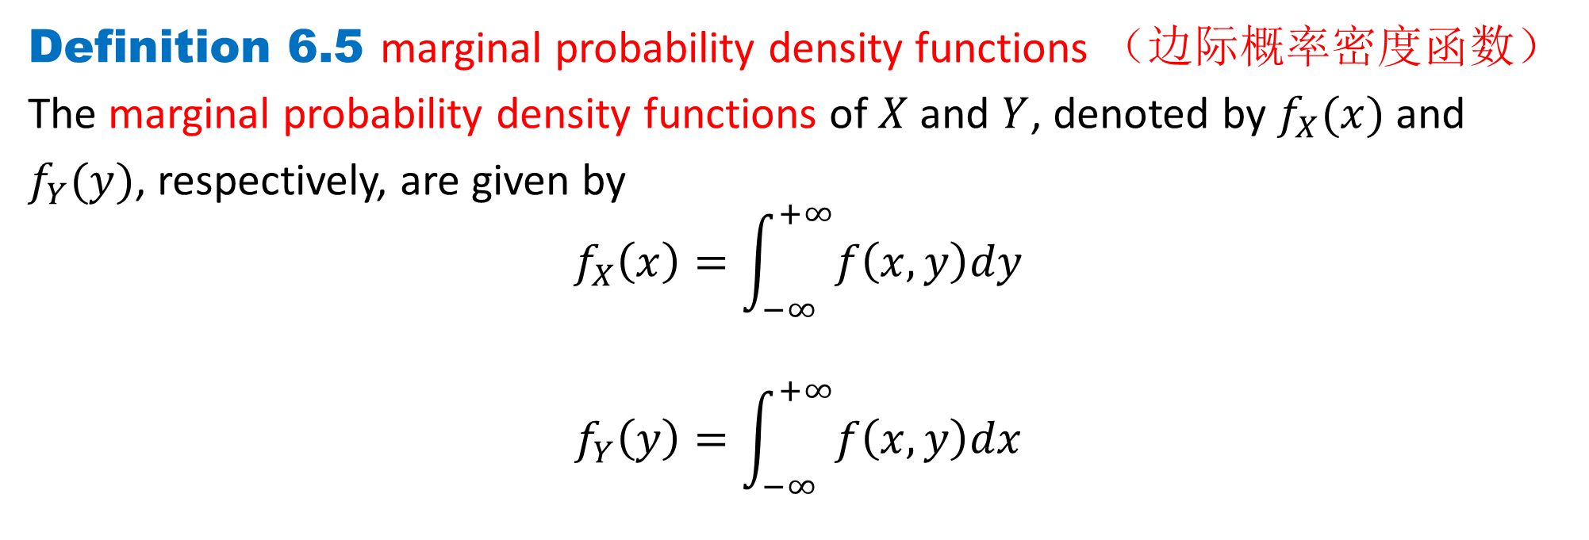
DLI
Definition 6.5 marginal probability density functions （边际概率密度函数）
The marginal probability density functions of $X$ and $Y$, denoted by $f_{X}(x)$ and
$f_{Y}(y)$, respectively, are given by
$$f_{X}\left(x\right)=\int_{−∞}^{+∞}{f\left(x, y\right)dy}$$
$$f_{Y}\left(y\right)=\int_{−∞}^{+∞}{f\left(x, y\right)dx}$$

Slide 16
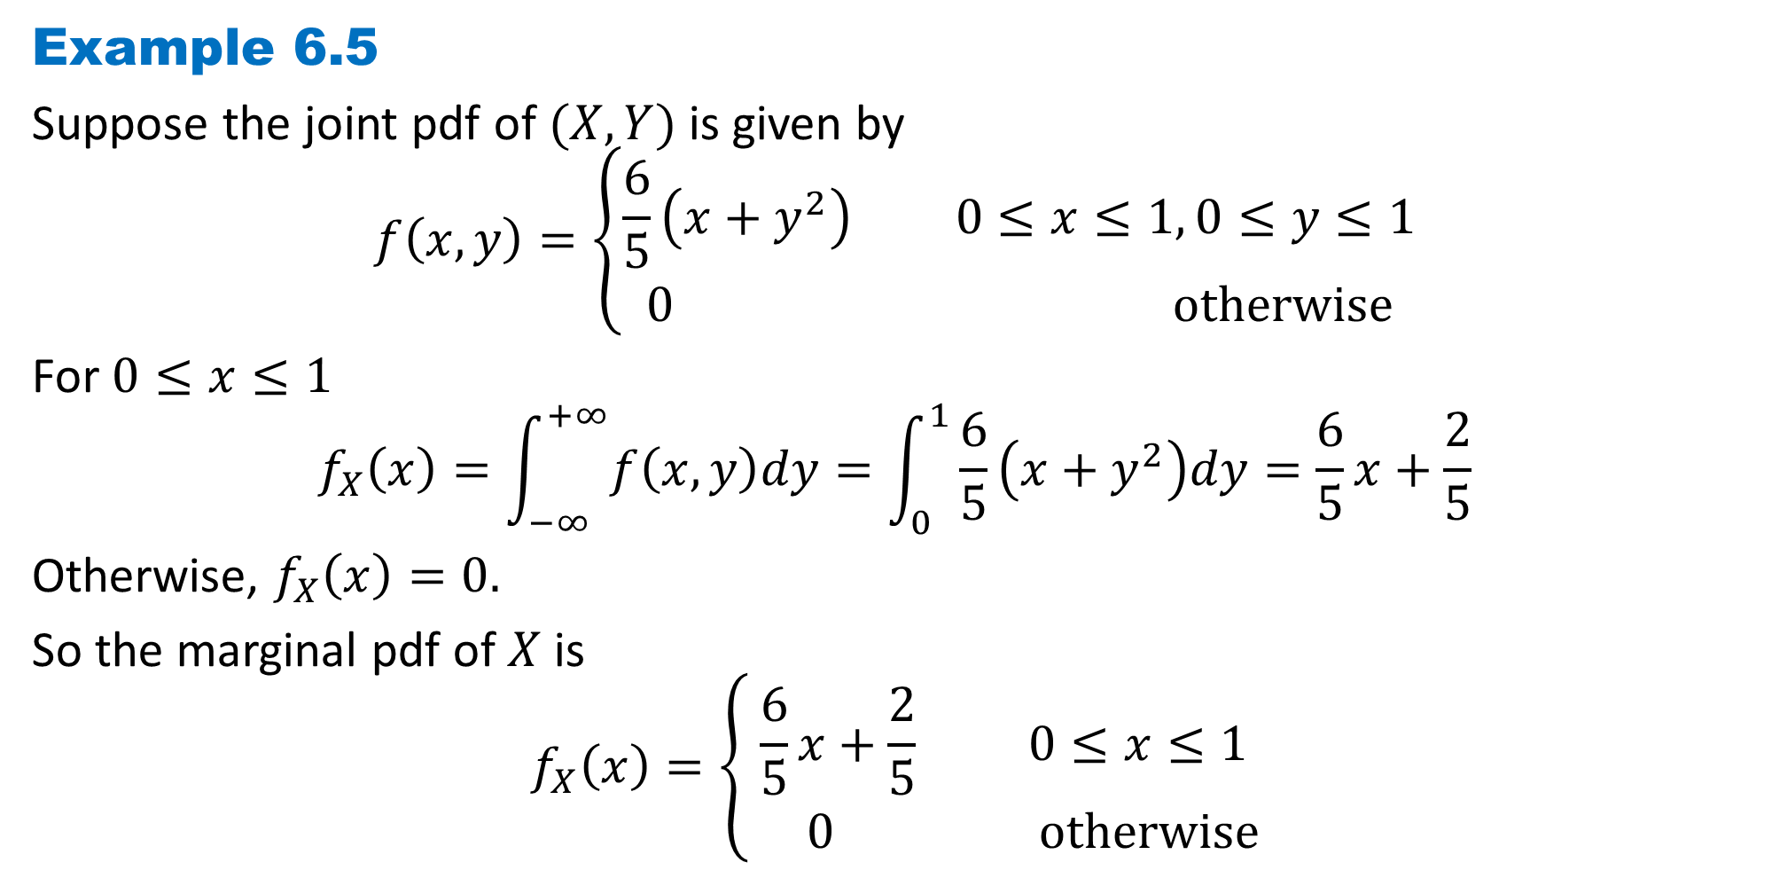
DLI
Example 6.5
Suppose the joint pdf of $(X, Y)$is given by
$$f\left(x,y\right)=\left\{\begin{aligned}\frac{6}{5}\left(x+y^{2}\right) 0≤x≤1, 0≤y≤1 \\ 0 otherwise\end{aligned}\right.$$
For $0≤x≤1$
$$f_{X}\left(x\right)=\int_{−∞}^{+∞}{f\left(x, y\right)dy}=\int_{0}^{1}{\frac{6}{5}\left(x+y^{2}\right)dy}=\frac{6}{5}x+\frac{2}{5}$$
Otherwise, $f_{X}\left(x\right)=0.$
So the marginal pdf of $X$ is
$$f_{X}\left(x\right)=\left\{\begin{aligned}\frac{6}{5}x+\frac{2}{5} 0≤x≤1 \\ 0 otherwise\end{aligned}\right.$$

Slide 17
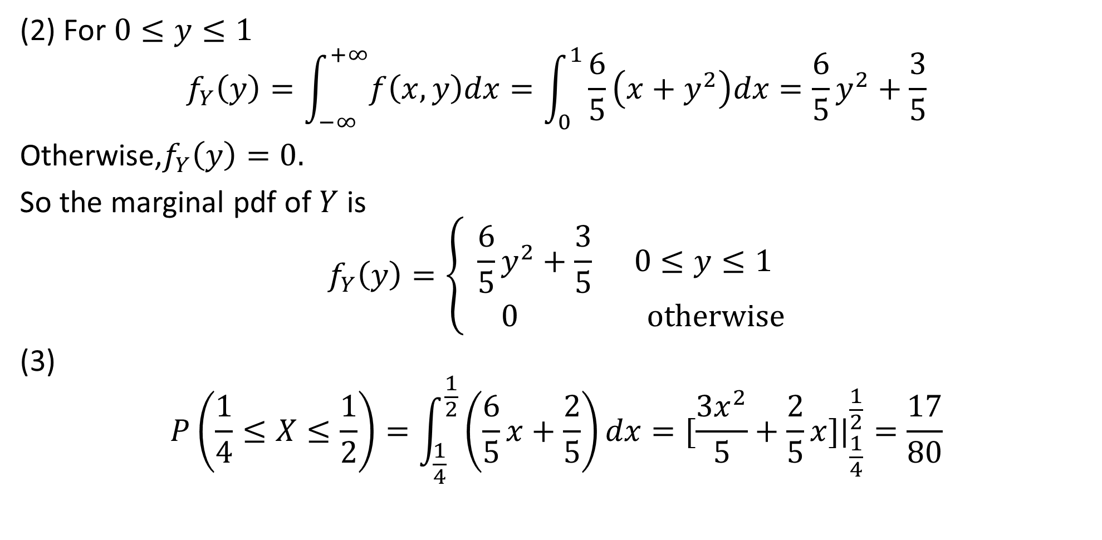
DLI
(2) For $0≤y≤1$
$$f_{Y}\left(y\right)=\int_{−∞}^{+∞}{f\left(x, y\right)dx}=\int_{0}^{1}{\frac{6}{5}\left(x+y^{2}\right)dx}=\frac{6}{5}y^{2}+\frac{3}{5}$$
Otherwise,$f_{Y}\left(y\right)=0.$
So the marginal pdf of $Y$ is
$$f_{Y}\left(y\right)=\left\{\begin{aligned}\frac{6}{5}y^{2}+\frac{3}{5} 0≤y≤1 \\ 0 otherwise\end{aligned}\right.$$
(3)
$$P\left(\frac{1}{4}≤X≤\frac{1}{2}\right)=\int_{\frac{1}{4}}^{\frac{1}{2}}{\left(\frac{6}{5}x+\frac{2}{5}\right)dx}=[\frac{{3x}^{2}}{5}+\frac{2}{5}x{]|}_{\frac{1}{4}}^{\frac{1}{2}}=\frac{17}{80}$$

Slide 18
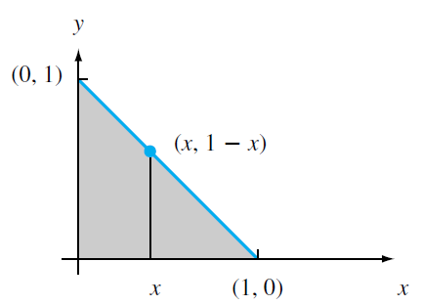
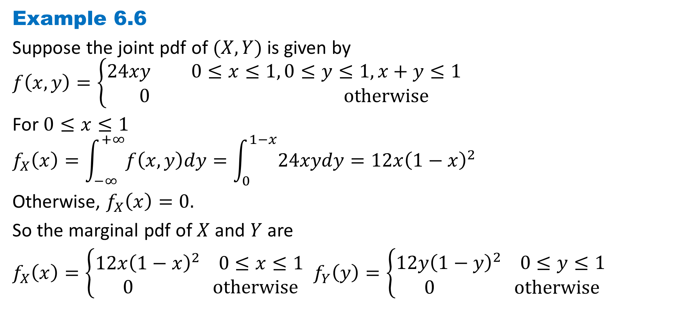
DLI
Example 6.6
Suppose the joint pdf of $(X, Y)$is given by
$$f\left(x,y\right)=\left\{\begin{aligned}24xy 0≤x≤1, 0≤y≤1, x+y≤1 \\ 0 otherwise\end{aligned}\right.$$
For $0≤x≤1$
$$f_{X}\left(x\right)=\int_{−∞}^{+∞}{f\left(x, y\right)dy}=\int_{0}^{1−x}{24xydy}=12x{\left(1−x\right)}^{2}$$
Otherwise, $f_{X}\left(x\right)=0.$
So the marginal pdf of $X$ and $Y$ are
$f_{X}\left(x\right)=\left\{\begin{aligned}12x{\left(1−x\right)}^{2} 0≤x≤1 \\ 0 otherwise\end{aligned}\right.$ $f_{Y}\left(y\right)=\left\{\begin{aligned}12y{\left(1−y\right)}^{2} 0≤y≤1 \\ 0 otherwise\end{aligned}\right.$

Slide 19
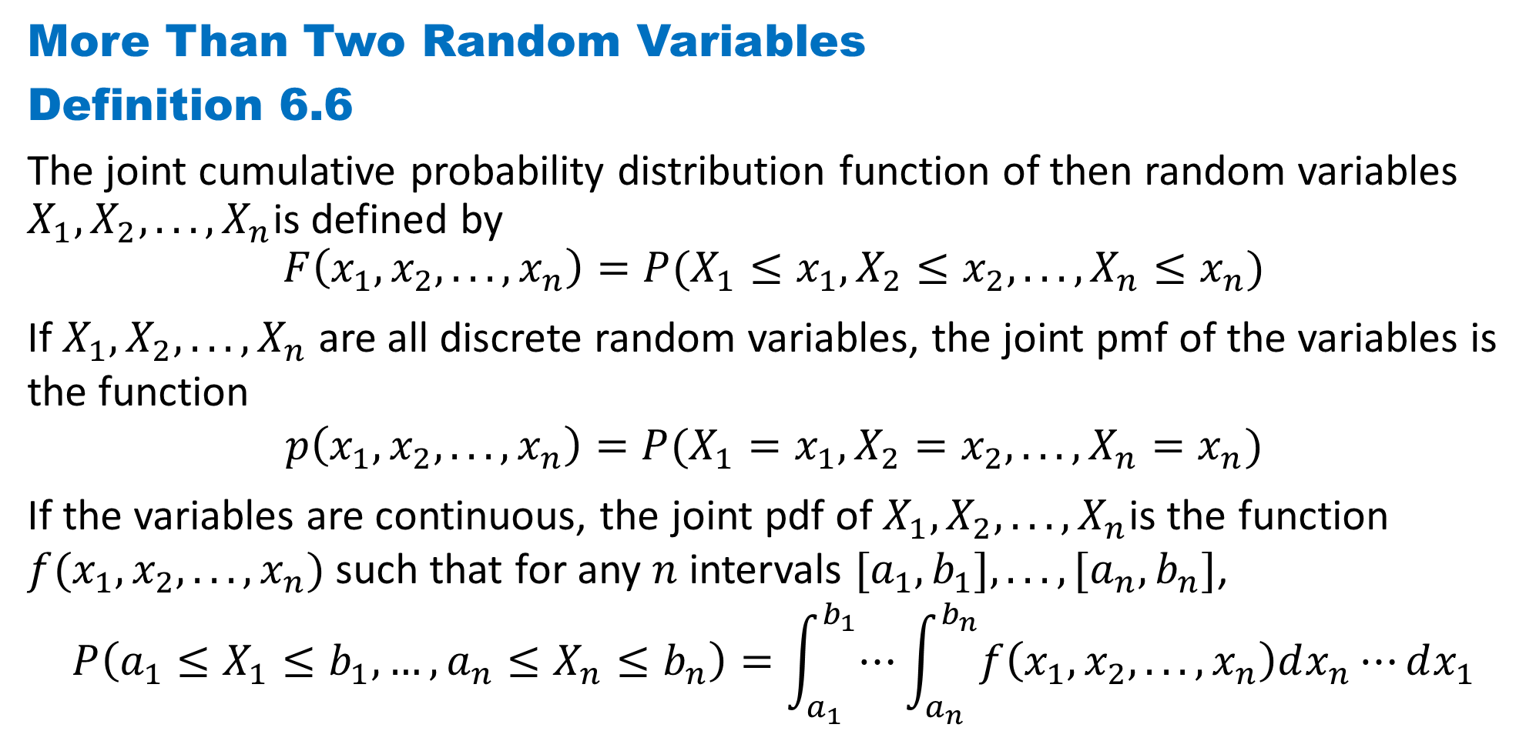
DLI
More Than Two Random Variables
Definition 6.6
The joint cumulative probability distribution function of then random variables $X_{1}, X_{2}, . . . , X_{n}$is defined by
$$F\left(x_{1}, x_{2}, . . . , x_{n}\right)=P(X_{1}≤x_{1}, X_{2}≤x_{2}, . . . , X_{n}≤x_{n})$$
If $X_{1}, X_{2}, . . . , X_{n}$ are all discrete random variables, the joint pmf of the variables is the function
$$p\left(x_{1}, x_{2}, . . . , x_{n}\right)=P(X_{1}=x_{1}, X_{2}=x_{2}, . . . , X_{n}=x_{n})$$
If the variables are continuous, the joint pdf of $X_{1}, X_{2}, . . . , X_{n}$is the function $f(x_{1}, x_{2}, . . . , x_{n})$such that for any $n$ intervals $[a_{1}, b_{1}], . . . , [a_{n}, b_{n}]$,
$$P\left(a_{1}≤X_{1}≤b_{1},…, a_{n}≤X_{n}≤b_{n}\right)=\int_{a_{1}}^{b_{1}}{⋯}\int_{a_{n}}^{b_{n}}{f\left(x_{1}, x_{2}, . . . , x_{n}\right)dx_{n}⋯}dx_{1}$$

Slide 20
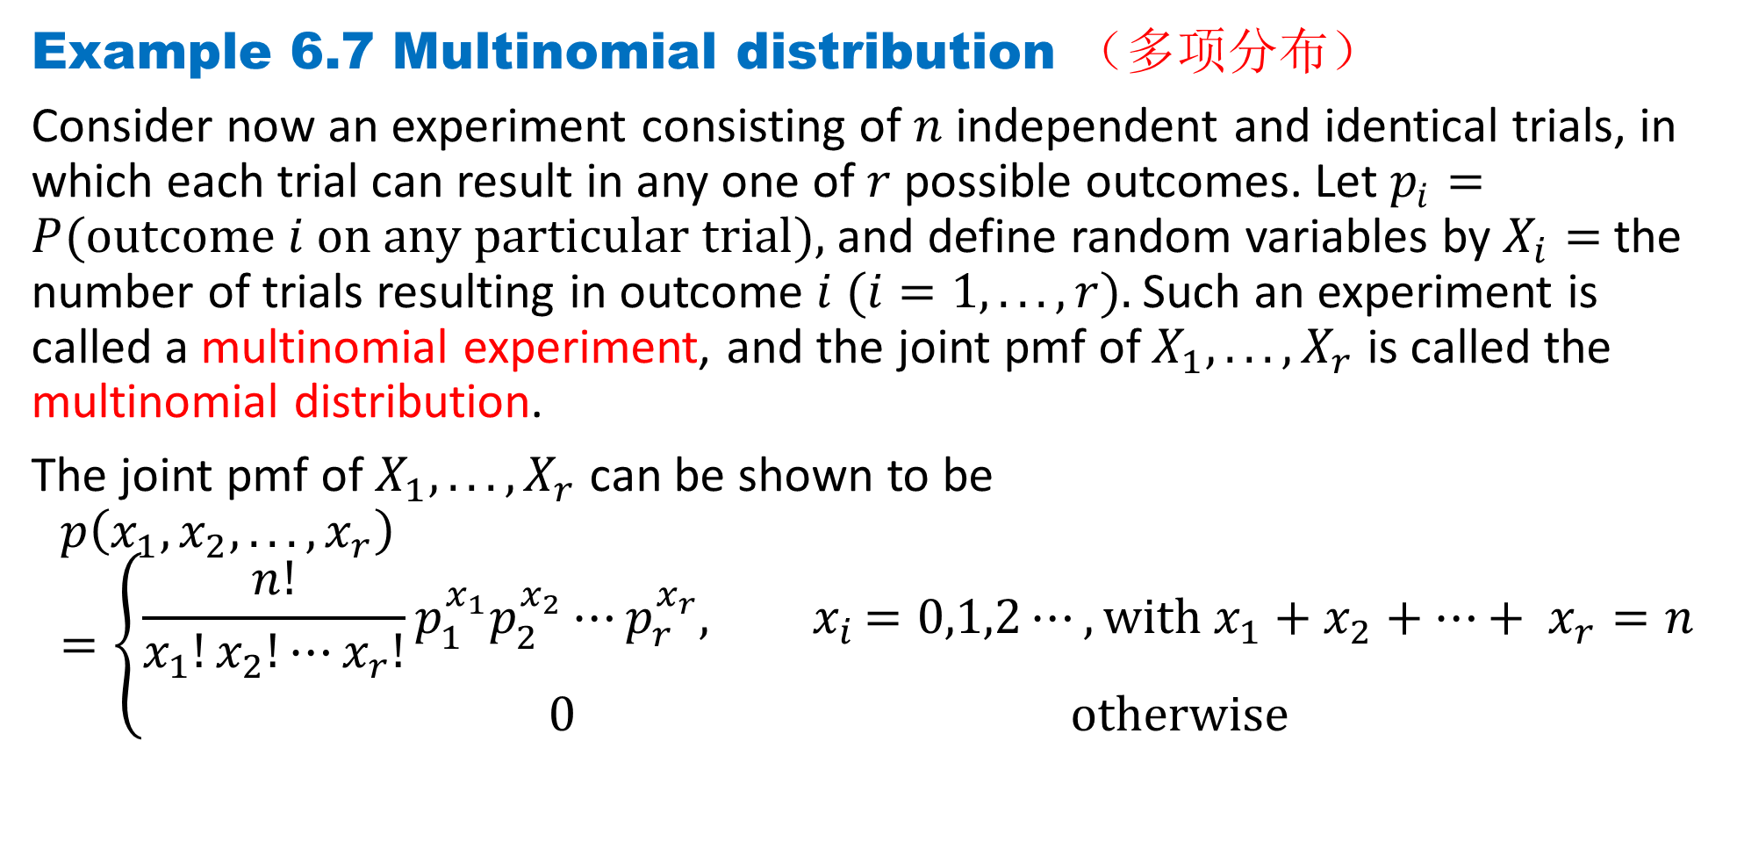
DLI
Example 6.7 Multinomial distribution （多项分布）
Consider now an experiment consisting of $n$ independent and identical trials, in which each trial can result in any one of $r$ possible outcomes. Let $p_{i}=P(outcome i on any particular trial),$and define random variables by $X_{i}=$the number of trials resulting in outcome $i (i=1, . . . , r).$Such an experiment is called a multinomial experiment, and the joint pmf of $X_{1}, . . . , X_{r}$ is called the multinomial distribution.
The joint pmf of $X_{1}, . . . , X_{r}$ can be shown to be
$$p\left(x_{1}, x_{2}, . . . , x_{r}\right)=\left\{\begin{aligned}\frac{n!}{x_{1}!x_{2}!⋯x_{r}!}p_{1}^{x_{1}}p_{2}^{x_{2}}⋯p_{r}^{x_{r}}{, x}_{i}=0,1,2⋯, with x_{1}+x_{2}+⋯+ x_{r}=n \\ 0 otherwise\end{aligned}\right.$$

Slide 21
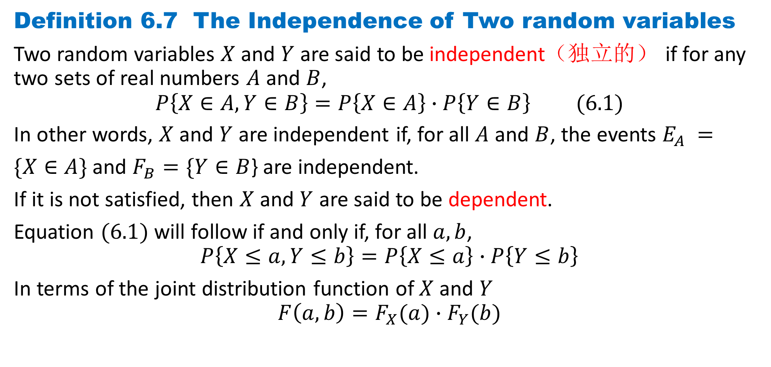
DLI
Definition 6.7 The Independence of Two random variables
Two random variables $X$and $Y$ are said to be independent（独立的） if for any two sets of real numbers $A$ and $B$,
$$P\left\{X∈A,Y∈B\right\}=P\left\{X∈A\right\}∙P\left\{Y∈B\right\} (6.1)$$
In other words, $X$and $Y$ are independent if, for all $A$ and $B$, the events $E_{A} =$
$\{X∈A\}$and $F_{B}=\{Y∈B$} are independent.
If it is not satisfied, then $X$ and $Y$ are said to be dependent.
Equation $(6.1)$will follow if and only if, for all $a, b$,
$$P\left\{X≤a,Y≤b\right\}=P\left\{X≤a\right\}∙P\left\{Y≤b\right\}$$
In terms of the joint distribution function of $X$and $Y$
$$F\left(a,b\right)=F_{X}(a)∙F_{Y}(b)$$

Slide 22
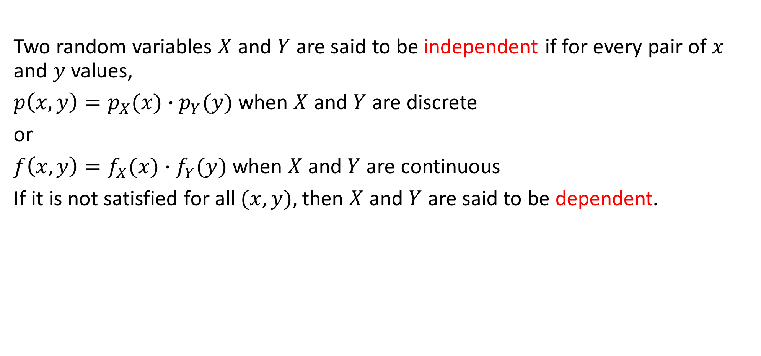
DLI
Two random variables $X$and $Y$ are said to be independent if for every pair of $x$ and $y$ values,
$p\left(x, y\right)=p_{X}(x)∙p_{Y}(y)$when $X$ and $Y$ are discrete
or
$f\left(x, y\right)=f_{X}(x)∙f_{Y}(y)$when $X$ and $Y$ are continuous
If it is not satisfied for all $(x, y),$then $X$ and $Y$ are said to be dependent.

Slide 23

DLI
Example 6.8
joint probability table
The marginal pmf of and $Y$are
Since $p\left(x, y\right)≠p_{X}(x)∙p_{Y}(y)$, $X$and $Y$ are not independent.

Slide 24
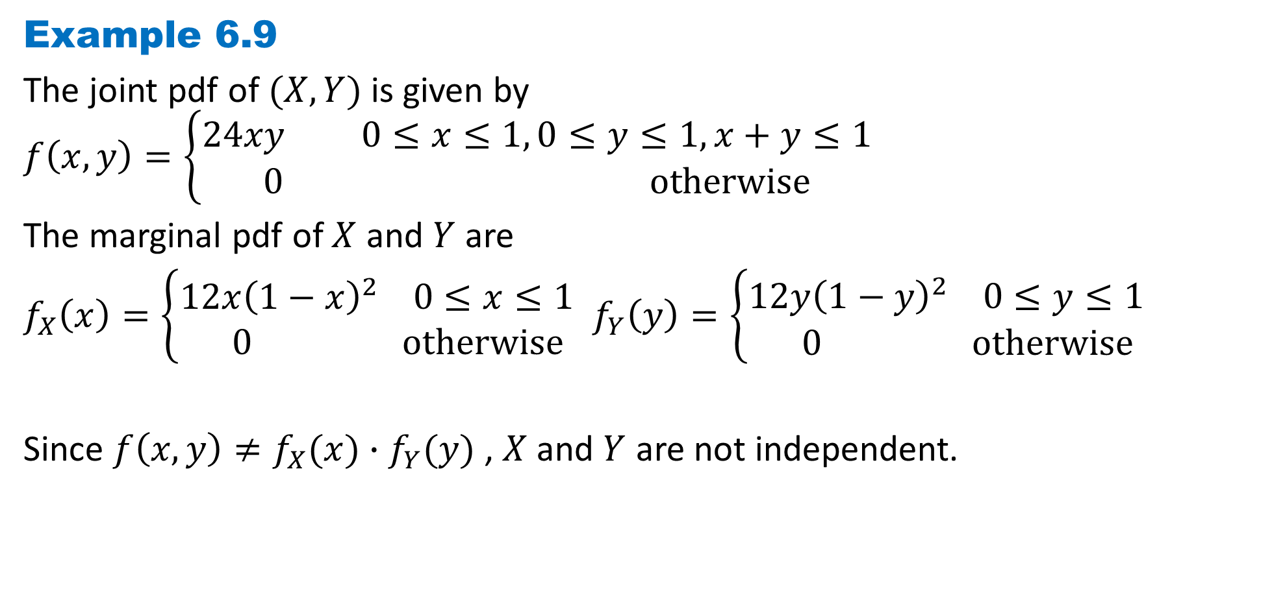
DLI
Example 6.9
The joint pdf of $(X, Y)$is given by
$$f\left(x,y\right)=\left\{\begin{aligned}24xy 0≤x≤1, 0≤y≤1, x+y≤1 \\ 0 otherwise\end{aligned}\right.$$
The marginal pdf of $X$ and $Y$ are
$f_{X}\left(x\right)=\left\{\begin{aligned}12x{\left(1−x\right)}^{2} 0≤x≤1 \\ 0 otherwise\end{aligned}\right.$ $f_{Y}\left(y\right)=\left\{\begin{aligned}12y{\left(1−y\right)}^{2} 0≤y≤1 \\ 0 otherwise\end{aligned}\right.$
Since $f\left(x, y\right)≠f_{X}(x)∙f_{Y}(y)$, $X$and $Y$ are not independent.

Slide 25
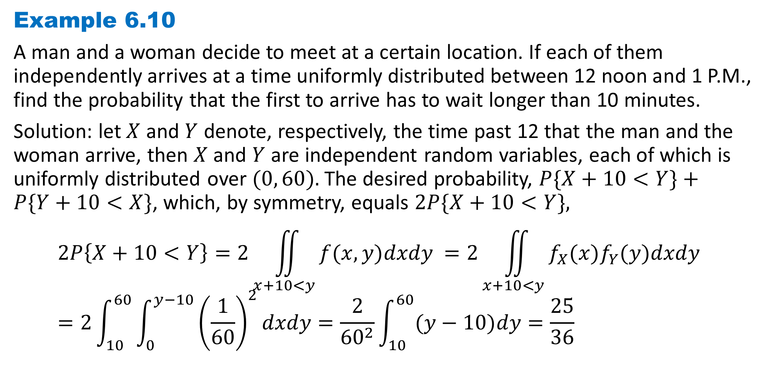
DLI
Example 6.10
A man and a woman decide to meet at a certain location. If each of them independently arrives at a time uniformly distributed between 12 noon and 1 P.M., find the probability that the first to arrive has to wait longer than 10 minutes.
Solution: let $X$ and $Y$ denote, respectively, the time past 12 that the man and the woman arrive, then $X$ and $Y$ are independent random variables, each of which is uniformly distributed over $(0, 60).$The desired probability, $P\{X+10<Y\}+P\{Y+10<X\}$, which, by symmetry, equals $2P\{X+10<Y\},$ $$2P\left\{X+10<Y\right\}=2\iint_{x+10<y}{f(x, y)dxdy }=2\iint_{x+10<y}{f_{X}(x)f_{Y}(y)dxdy }=2\int_{10}^{60}{\int_{0}^{y−10}{{\left(\frac{1}{60}\right)}^{2}}dxdy}=\frac{2}{{60}^{2}}\int_{10}^{60}{(y−10)dy}=\frac{25}{36}$$

Slide 26

DLI
Proposition 6.1
The continuous (discrete) random variables $X$ and $Y$ are independent if and only if their joint probability density (mass) function can be expressed as
$$f\left(x, y\right)=h\left(x\right)∙g\left(y\right),−∞<x<∞,−∞<y<∞$$

Slide 27
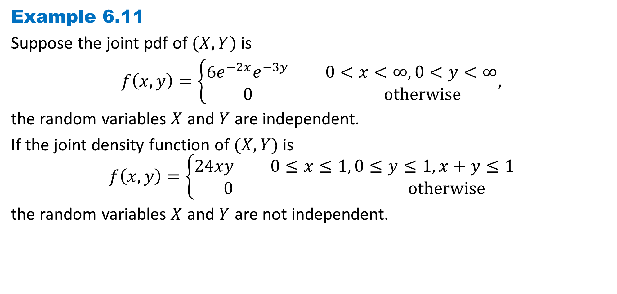
DLI
Example 6.11
Suppose the joint pdf of $(X, Y)$is
$f\left(x,y\right)=\left\{\begin{aligned}6e^{−2x}e^{−3y} 0<x<∞,0<y<∞ \\ 0 otherwise\end{aligned}\right.$,
the random variables $X$ and $Y$ are independent.
If the joint density function of $(X, Y)$is
$$f\left(x,y\right)=\left\{\begin{aligned}24xy 0≤x≤1, 0≤y≤1, x+y≤1 \\ 0 otherwise\end{aligned}\right.$$
the random variables $X$ and $Y$ are not independent.

Slide 28
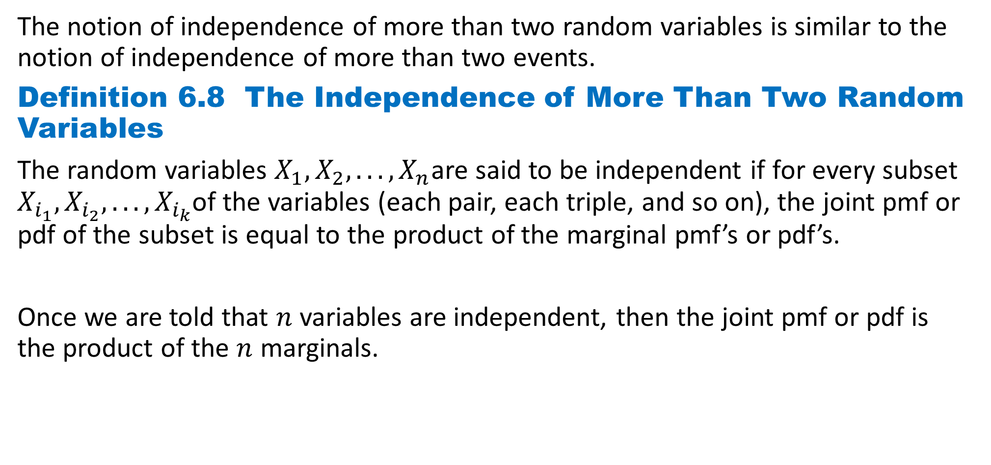
DLI
The notion of independence of more than two random variables is similar to the notion of independence of more than two events.
Definition 6.8 The Independence of More Than Two Random Variables
The random variables $X_{1}, X_{2}, . . . , X_{n}$are said to be independent if for every subset $X_{i_{1}}, X_{i_{2}}, . . . , X_{i_{k}}$of the variables (each pair, each triple, and so on), the joint pmf or pdf of the subset is equal to the product of the marginal pmf’s or pdf’s.
Once we are told that $n$ variables are independent, then the joint pmf or pdf is the product of the $n$ marginals.

Slide 29
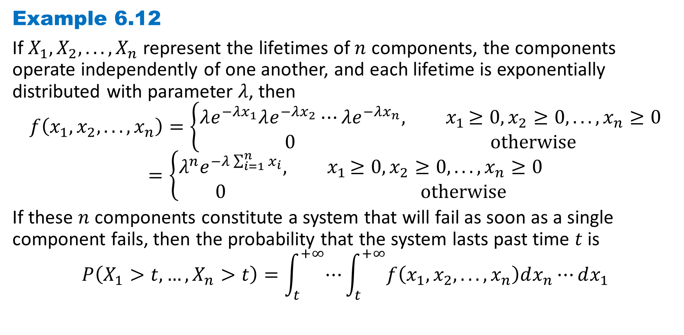
DLI
Example 6.12
If $X_{1}, X_{2}, . . . , X_{n}$ represent the lifetimes of $n$ components, the components operate independently of one another, and each lifetime is exponentially distributed with parameter $λ$, then
$$f\left(x_{1}, x_{2}, . . . , x_{n}\right)=\left\{\begin{aligned}λe^{−λx_{1}}λe^{−λx_{2}}⋯λe^{−λx_{n}}{, x}_{1}≥0, x_{2}≥0, . . . , x_{n}≥0 \\ 0 otherwise\end{aligned}\right.$$
$$=\left\{\begin{aligned}λ^{n}e^{−λ\sum_{i=1}^{n}{x_{i}}}{, x}_{1}≥0, x_{2}≥0, . . . , x_{n}≥0 \\ 0 otherwise\end{aligned}\right.$$
If these $n$ components constitute a system that will fail as soon as a single component fails, then the probability that the system lasts past time $t$ is
$$P\left(X_{1}>t,…, X_{n}>t\right)=\int_{t}^{+∞}{⋯}\int_{t}^{+∞}{f\left(x_{1}, x_{2}, . . . , x_{n}\right)dx_{n}⋯}dx_{1}$$

Slide 30
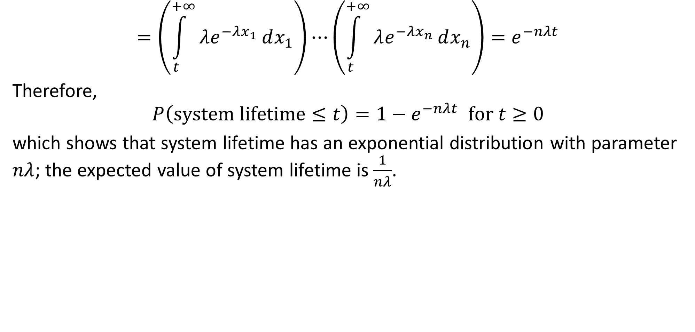
DLI
$$=\left(\int_{t}^{+∞}{λe^{−λx_{1}}}dx_{1}\right)⋯\left(\int_{t}^{+∞}{λe^{−λx_{n}}}dx_{n}\right)=e^{−nλt}$$
Therefore,
$$P\left(system lifetime≤t\right)=1−e^{−nλt} for t≥0$$
which shows that system lifetime has an exponential distribution with parameter $nλ$; the expected value of system lifetime is $\frac{1}{nλ}$.

Slide 31
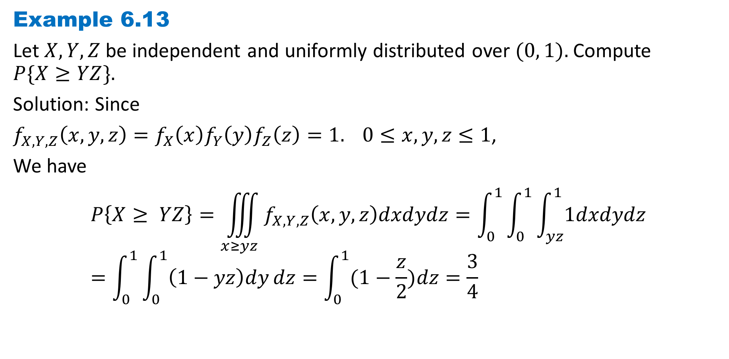
DLI
Example 6.13
Let $X, Y, Z$be independent and uniformly distributed over $(0, 1).$Compute
$$P\{X≥YZ\}.$$
Solution: Since
$f_{X,Y,Z}\left(x,y,z\right)=f_{X}\left(x\right)f_{Y}\left(y\right)f_{Z}\left(z\right)=1. 0≤x,y,z≤1$,
We have $$P\left\{X≥ YZ\right\}=\iiint_{x≥yz}{f_{X,Y,Z}\left(x,y,z\right)dxdydz}=\int_{0}^{1}{\int_{0}^{1}{\int_{yz}^{1}{1dxdydz}}}=\int_{0}^{1}{\int_{0}^{1}{\left(1−yz\right)dy}dz}=\int_{0}^{1}{(1−\frac{z}{2})dz}=\frac{3}{4}$$

Slide 32
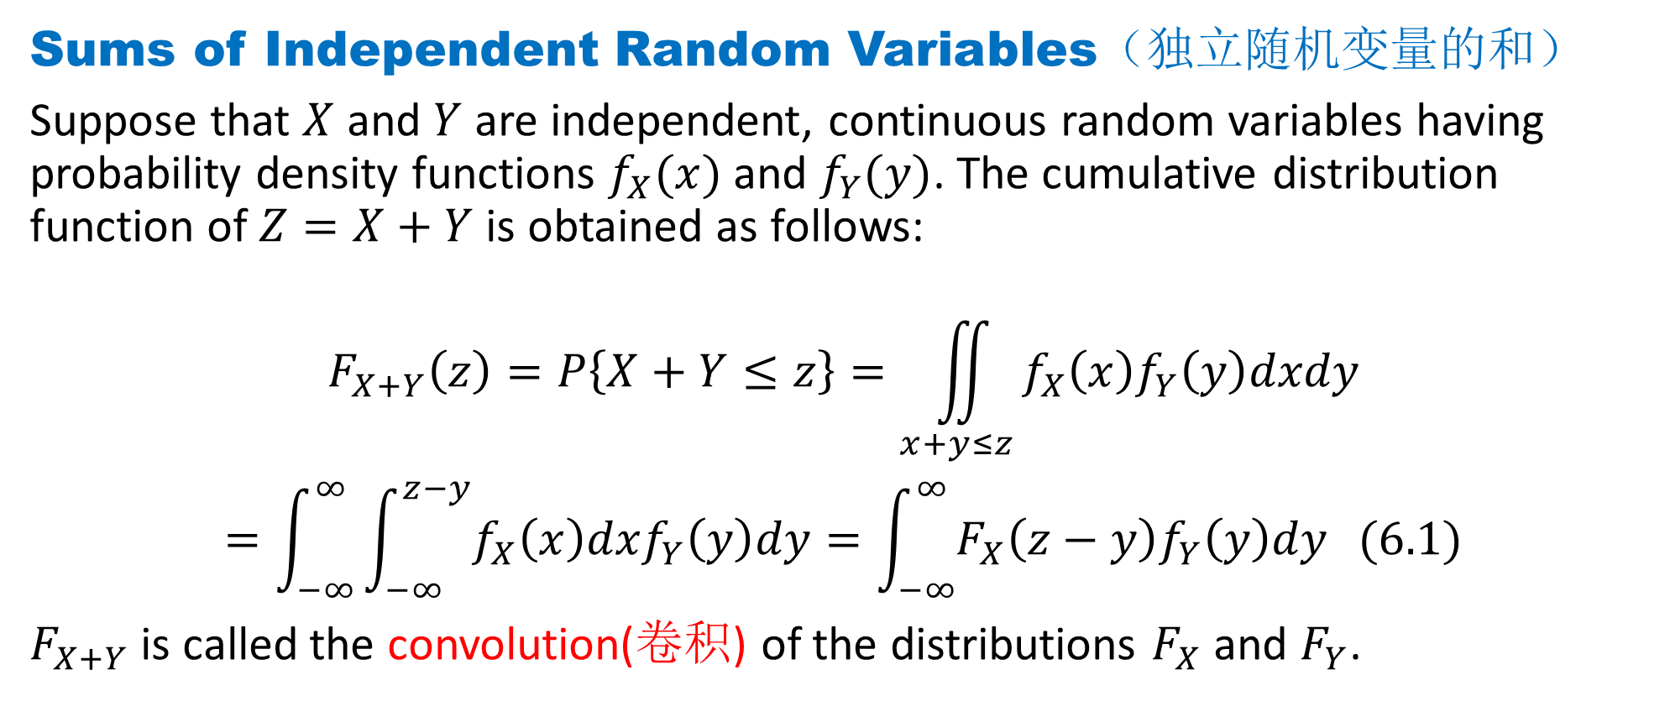
DLI
Sums of Independent Random Variables（独立随机变量的和）
Suppose that $X$ and $Y$ are independent, continuous random variables having probability density functions $f_{X}(x)$ and $f_{Y}(y)$. The cumulative distribution function of $Z=X+Y$is obtained as follows:
$$F_{X+Y}\left(z\right)=P\left\{X+Y≤z\right\}=\iint_{x+y≤z}{f_{X}\left(x\right)f_{Y}\left(y\right)dxdy}$$
$$=\int_{−∞}^{∞}{\int_{−∞}^{z−y}{f_{X}\left(x\right)dxf_{Y}\left(y\right)dy}}=\int_{−∞}^{∞}{F_{X}\left(z−y\right)f_{Y}\left(y\right)dy} (6.1)$$
$F_{X+Y}$ is called the convolution(卷积) of the distributions $F_{X}$ and $F_{Y}$.

Slide 33
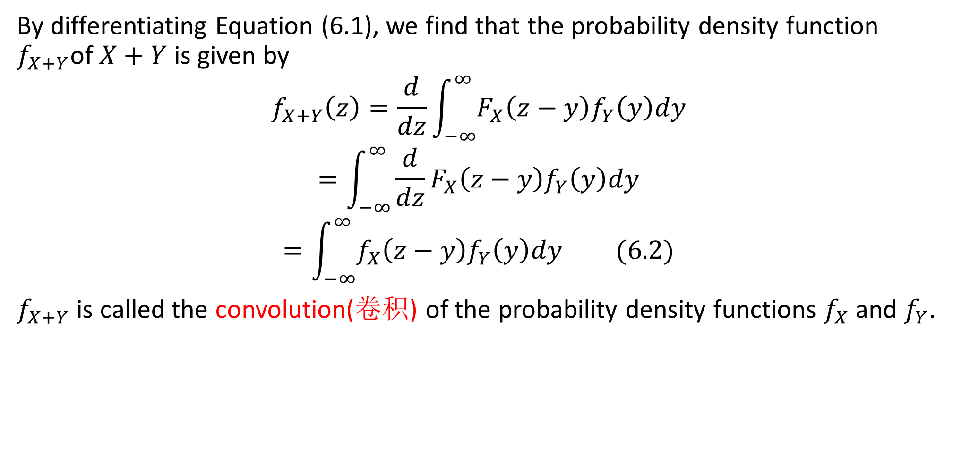
DLI
By differentiating Equation (6.1), we find that the probability density function $f_{X+Y}$of $X+Y$is given by
$$f_{X+Y}\left(z\right)=\frac{d}{dz}\int_{−∞}^{∞}{F_{X}\left(z−y\right)f_{Y}\left(y\right)dy}$$
$$=\int_{−∞}^{∞}{{\frac{d}{dz}F}_{X}\left(z−y\right)f_{Y}\left(y\right)dy}$$
$$=\int_{−∞}^{∞}{f_{X}\left(z−y\right)f_{Y}\left(y\right)dy }(6.2)$$
$f_{X+Y}$ is called the convolution(卷积) of the probability density functions $f_{X}$ and $f_{Y}$.

Slide 34
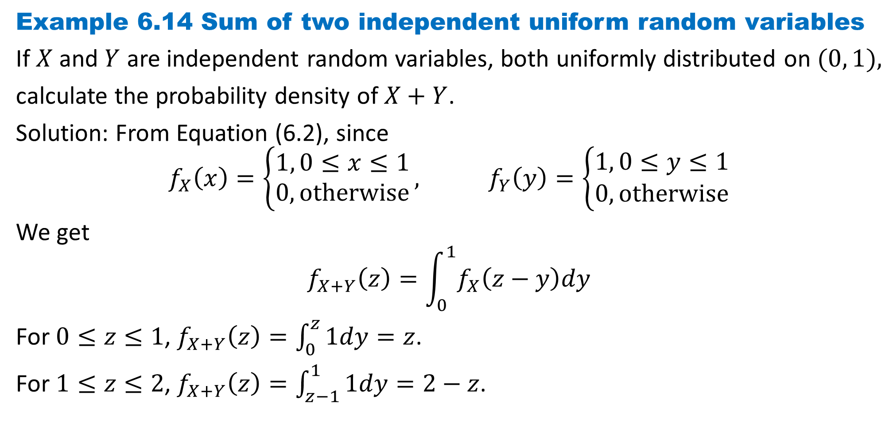
DLI
Example 6.14 Sum of two independent uniform random variables
If $X$ and $Y$ are independent random variables, both uniformly distributed on $(0, 1),$
calculate the probability density of $X+Y$.
Solution: From Equation (6.2), since
$$f_{X}\left(x\right)=\left\{\begin{aligned}1, 0≤x≤1 \\ 0, otherwise\end{aligned}\right., f_{Y}\left(y\right)=\left\{\begin{aligned}1, 0≤y≤1 \\ 0, otherwise\end{aligned}\right.$$
We get
$$f_{X+Y}\left(z\right)=\int_{0}^{1}{f_{X}\left(z−y\right)dy}$$
For $0≤z≤1$, $f_{X+Y}\left(z\right)=\int_{0}^{z}{1dy}=z$.
For $1≤z≤2$, $f_{X+Y}\left(z\right)=\int_{z−1}^{1}{1dy}=2−z$.

Slide 35
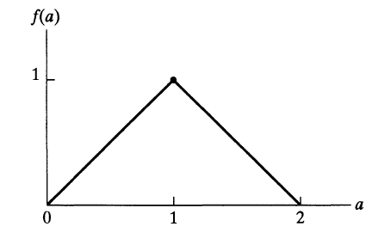

DLI
Hence
$$f_{X+Y}\left(z\right)=\left\{\begin{aligned}z, 0≤z≤1, \\ 2−z,1<z≤2, \\ 0, otherwise\end{aligned}\right.$$

Slide 36
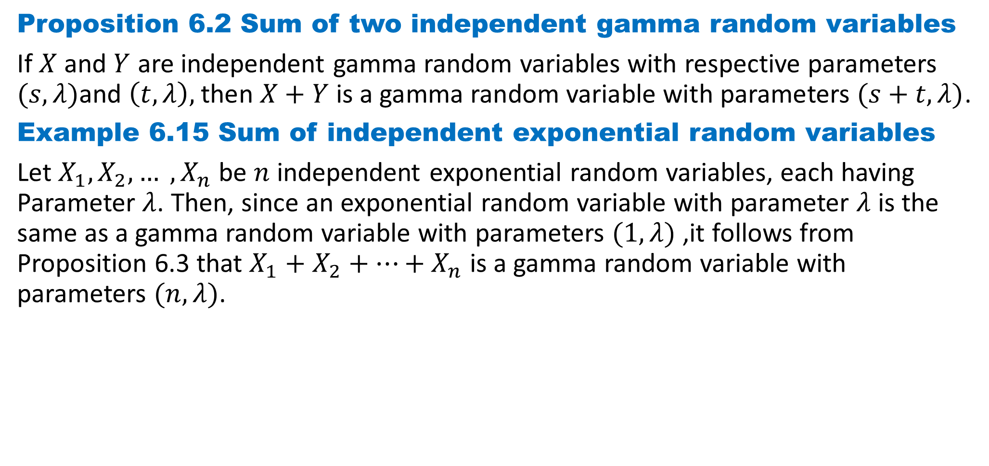
DLI
Proposition 6.2 Sum of two independent gamma random variables
If $X$ and $Y$ are independent gamma random variables with respective parameters $(s, λ)$and $\left(t, λ\right),$then $X+Y$ is a gamma random variable with parameters $(s+t, λ)$.
Example 6.15 Sum of independent exponential random variables
Let $X_{1}, X_{2}, … , X_{n}$be $n$ independent exponential random variables, each having Parameter $λ$. Then, since an exponential random variable with parameter $λ$ is the same as a gamma random variable with parameters $(1,λ)$ ,it follows from Proposition 6.3 that $X_{1}+X_{2}+…+X_{n}$ is a gamma random variable with parameters $(n,λ)$.

Slide 37
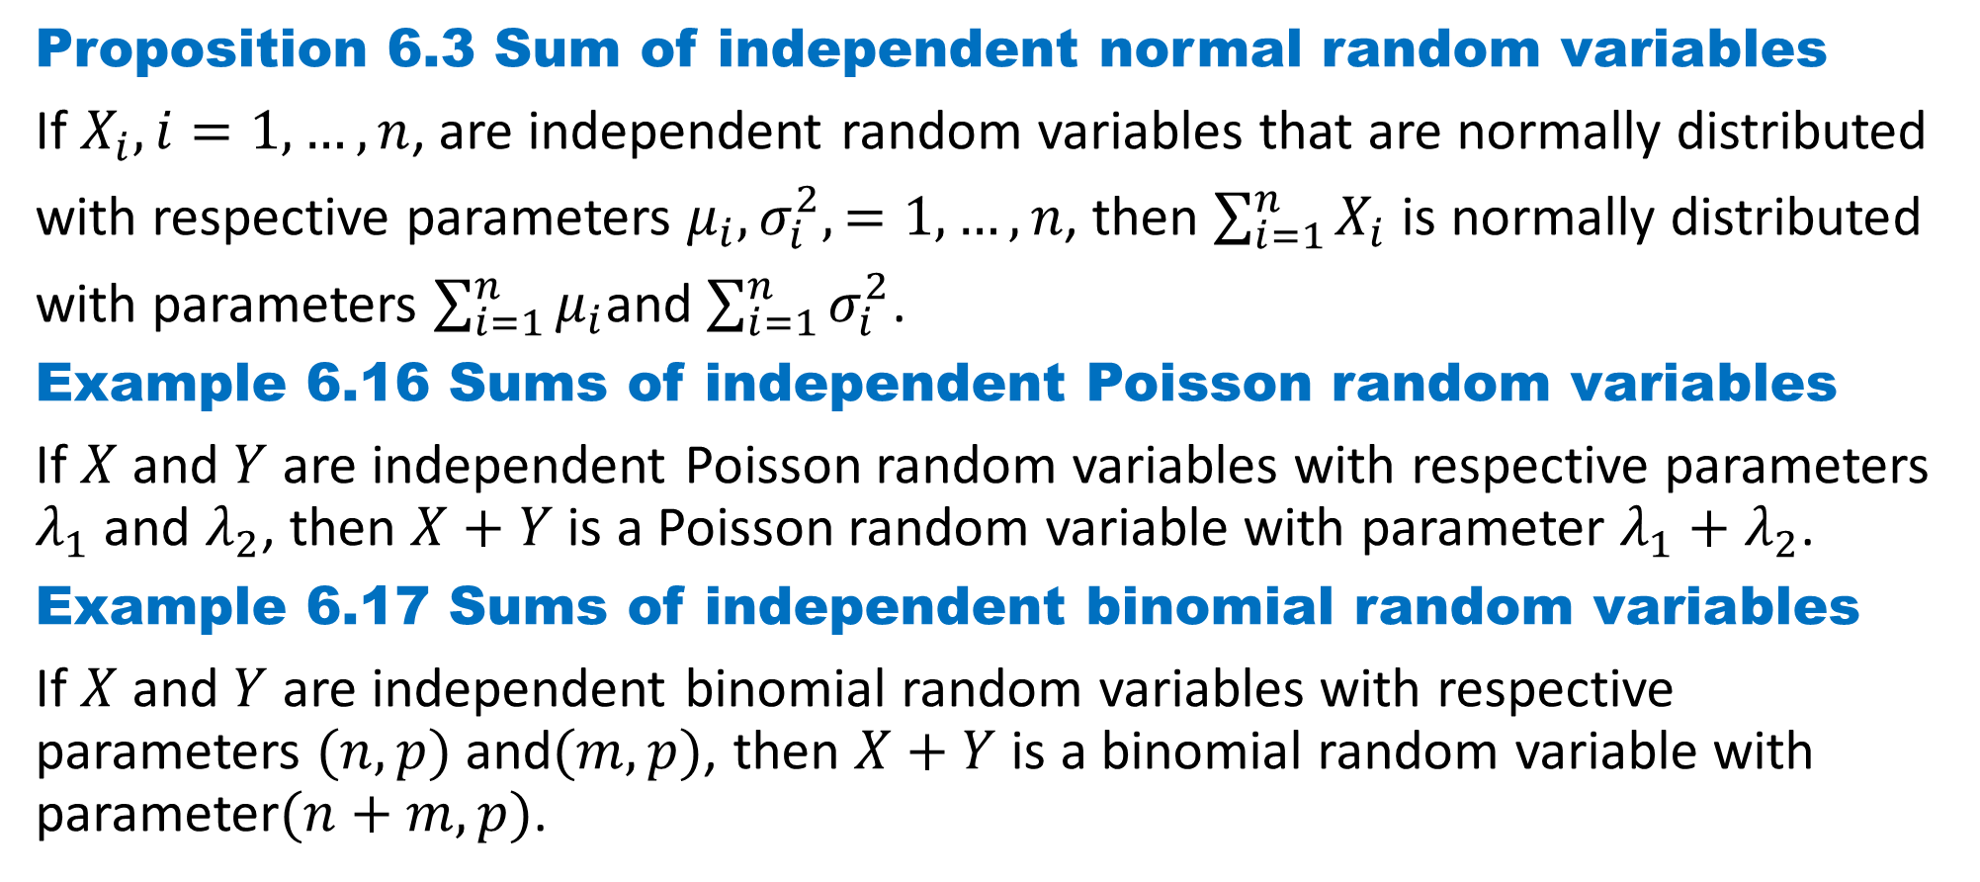
DLI
Proposition 6.3 Sum of independent normal random variables
If $X_{i}, i=1, …, n$, are independent random variables that are normally distributed
with respective parameters $μ_{i},σ_{i}^{2},=1, …, n$, then $\sum_{i=1}^{n}{X_{i}}$ is normally distributed
with parameters $\sum_{i=1}^{n}{μ_{i}}$and $\sum_{i=1}^{n}{σ_{i}^{2}}$.
Example 6.16 Sums of independent Poisson random variables
If $X$and $Y$ are independent Poisson random variables with respective parameters $λ_{1}$ and $λ_{2}$, then $X+Y$ is a Poisson random variable with parameter $λ_{1}+λ_{2}$.
Example 6.17 Sums of independent binomial random variables
If $X$and $Y$ are independent binomial random variables with respective parameters $(n,p)$ and$(m,p)$, then $X+Y$ is a binomial random variable with parameter$(n+m,p)$.

Slide 38
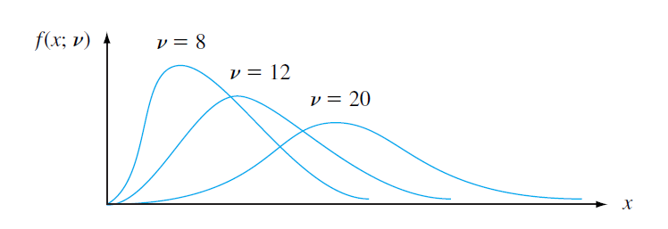
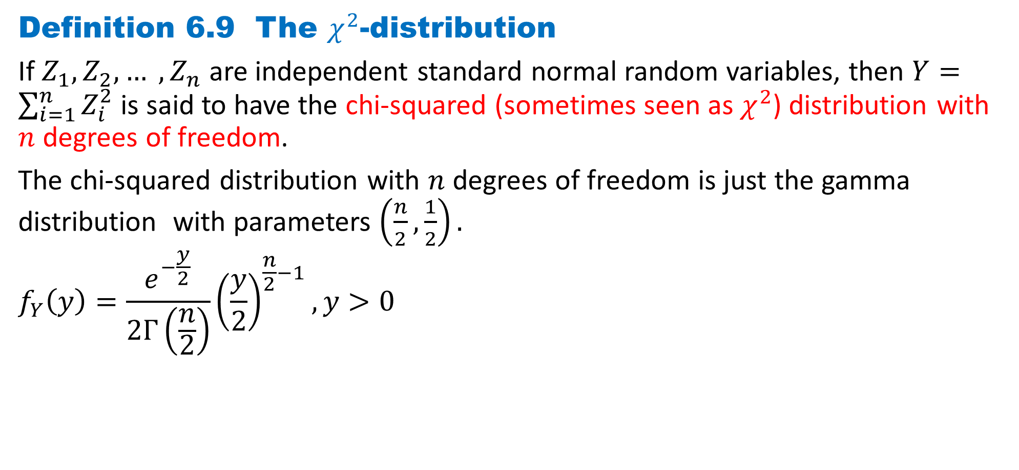
DLI
Definition 6.9 The $χ^{2}$-distribution
If $Z_{1}, Z_{2}, … , Z_{n}$are independent standard normal random variables, then $Y=\sum_{i=1}^{n}{Z_{i}^{2}}$ is said to have the chi-squared (sometimes seen as $χ^{2}$) distribution with $n$ degrees of freedom.
The chi-squared distribution with $n$ degrees of freedom is just the gamma distribution with parameters $\left(\frac{n}{2},\frac{1}{2}\right).$
$$f_{Y}\left(y\right)=\frac{e^{−\frac{y}{2}}}{2Γ\left(\frac{n}{2}\right)}{\left(\frac{y}{2}\right)}^{\frac{n}{2}−1},y>0$$

Slide 39
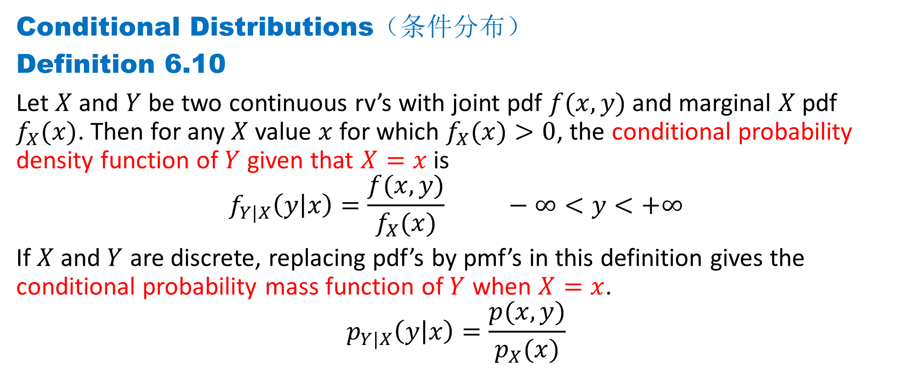
DLI
Conditional Distributions（条件分布）
Definition 6.10
Let $X$ and $Y$ be two continuous rv’s with joint pdf $f(x, y)$and marginal $X$ pdf $f_{X}(x)$. Then for any $X$ value $x$ for which $f_{X}(x)>0$, the conditional probability density function of $Y$ given that $X=x$is
$$f_{Y|X}\left(y | x\right)=\frac{f(x,y)}{f_{X}(x)} −∞<y<+∞$$
If $X$ and $Y$ are discrete, replacing pdf’s by pmf’s in this definition gives the conditional probability mass function of $Y$ when $X=x$.
$$p_{Y|X}\left(y | x\right)=\frac{p(x,y)}{p_{X}(x)}$$

Slide 40
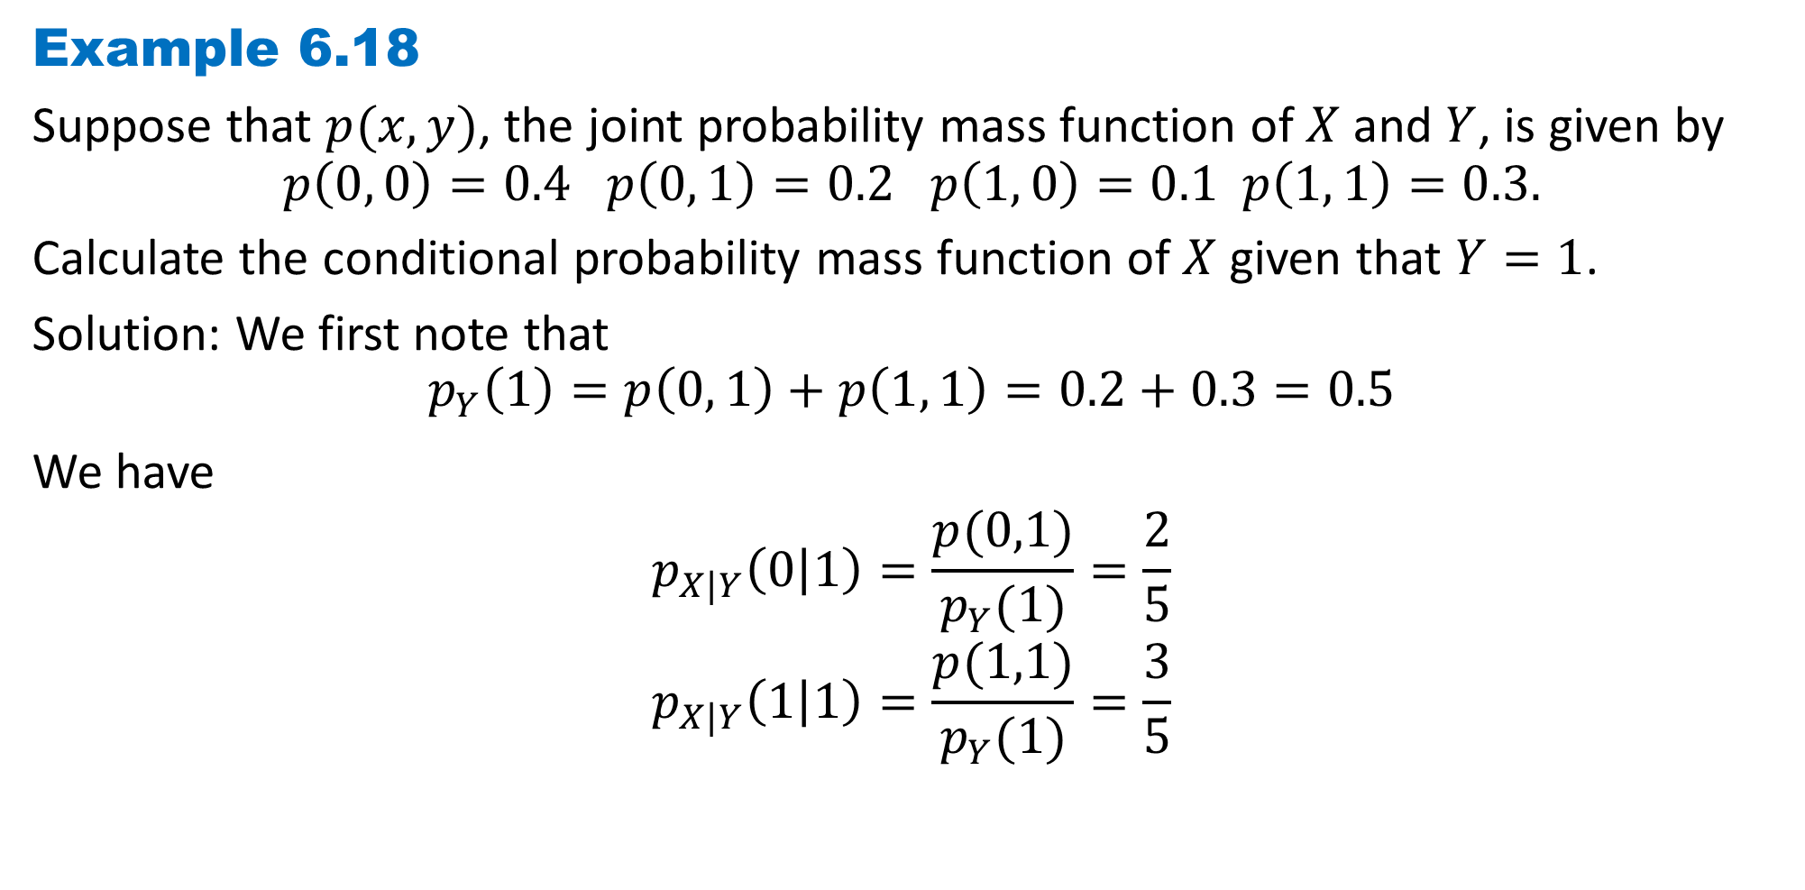
DLI
Example 6.18
Suppose that $p(x,y)$, the joint probability mass function of $X$ and $Y$, is given by
$$p\left(0, 0\right)=0.4 p\left(0, 1\right)=0.2 p\left(1, 0\right)=0.1 p\left(1, 1\right)=0.3.$$
Calculate the conditional probability mass function of $X$ given that $Y=1$.
Solution: We first note that
$$p_{Y}\left(1\right)=p\left(0, 1\right)+p\left(1, 1\right)=0.2+0.3=0.5$$
We have $$p_{X|Y}\left(0 | 1\right)=\frac{p(0,1)}{p_{Y}(1)}=\frac{2}{5}$$
$$p_{X|Y}\left(1 | 1\right)=\frac{p(1,1)}{p_{Y}(1)}=\frac{3}{5}$$

Slide 41
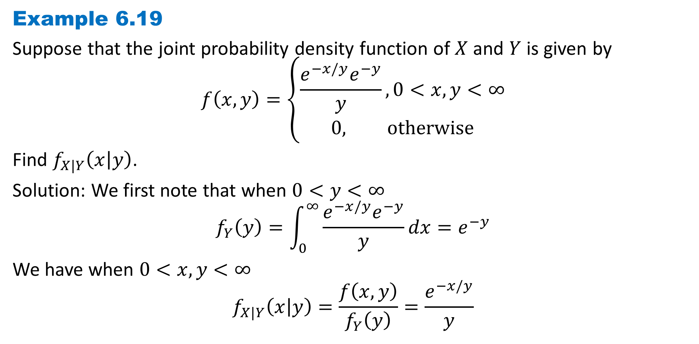
DLI
Example 6.19
Suppose that the joint probability density function of $X$ and $Y$ is given by
$$f\left(x, y\right)=\left\{\begin{aligned}\frac{e^{−x/y}e^{−y}}{y},0<x,y<∞ \\ 0, otherwise\end{aligned}\right.$$
Find $f_{X|Y}\left(x | y\right)$.
Solution: We first note that when $0<y<∞$
$$f_{Y}\left(y\right)=\int_{0}^{∞}{\frac{e^{−x/y}e^{−y}}{y}dx}=e^{−y}$$
We have when $0<x,y<∞$ $$f_{X|Y}\left(x | y\right)=\frac{f\left(x, y\right)}{f_{Y}\left(y\right)}=\frac{e^{−x/y}}{y}$$

Slide 42
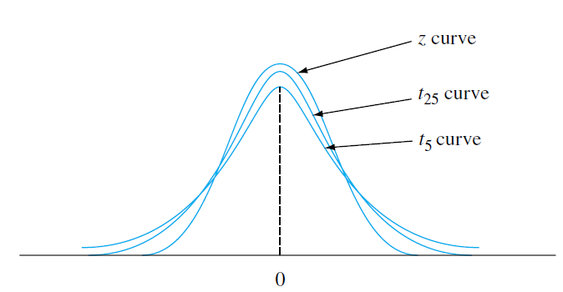

DLI
Definition 6.20 The t-distribution
If $Z$ and $Y$ are independent, with $Z$ having a standard normal distribution and $Y$ having a chi-squared distribution with $n$ degrees of freedom, then the random variable $T$ defined by
$$T=\frac{Z}{\sqrt{Y/n}}$$
is said to have a $t$-distribution
with $n$ degrees of freedom.
$$f_{T}(t)=\frac{Γ\left(\frac{n+1}{2}\right)}{\sqrt{nπ}Γ\left(\frac{n}{2}\right)}{\left(1+\frac{t^{2}}{n}\right)}^{−\frac{n+1}{2}}$$

Slide 43
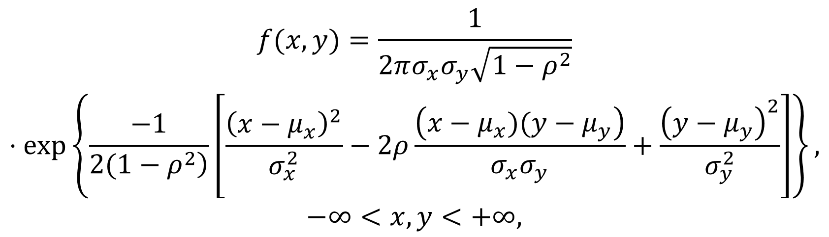
DLI
Definition 6.21 Bivariate normal distribution 二维正态分布
$$\left(X,Y\right)\text{\sim }\text{N}\text{(}μ_{x},μ_{y},σ_{x}^{2},σ_{y}^{2},ρ)$$
$$\begin{matrix}f(x,y)=\frac{1}{2πσ_{x}σ_{y}\sqrt{1−ρ^{2}}} \\ ⋅exp\left\{\frac{−1}{\left.2(1−ρ^{2}\right)}\left[\frac{{\left(x−μ_{x}\right)}^{2}}{σ_{x}^{2}}−2ρ\frac{\left(x−μ_{x})(y−μ_{y}\right)}{σ_{x}σ_{y}}+\frac{{\left(y−μ_{y}\right)}^{2}}{σ_{y}^{2}}\right]\right\}, \\ −∞<x,y<+∞,\end{matrix}$$
$\text{X}\text{\sim }\text{N}(μ_{x}, σ_{x}^{2})$, $\text{Y}\text{\sim }\text{N}\text{(}μ_{y}, σ_{y}^{2})$

Slide 44
DLI
Homework
Page 290 Problems
1, 8, 9, 10, 15, 19, 20, 40, 41,
Page 294 Theoretical Exercises
6, 25
Page 296 Self-Test Problems and Exercises
2, 6, 7

